Slide 1

Hidden Markov Models
March, 2019

Slide 2
CG-Islands
CG Island region
non-CG Island region
 | A | C | G | T
A | 0.053 | 0.079 | 0.127 | 0.036
C | 0.037 | 0.058 | 0.058 | 0.041
G | 0.035 | 0.075 | 0.081 | 0.026
T | 0.024 | 0.105 | 0.115 | 0.050
 | A | C | G | T
A | 0.087 | 0.058 | 0.084 | 0.061
C | 0.067 | 0.063 | 0.017 | 0.063
G | 0.053 | 0.053 | 0.063 | 0.042
T | 0.051 | 0.070 | 0.084 | 0.084

Slide 3
Hidden Markov Model
An alphabet 𝛴 of emitted symbols
A set States of hidden states
A |States| x |States| matrix transition = (transitionl,k) of transition probabilities, where transitionl,k represents the probability of moving form state l to state k
A |States| x | 𝛴 | matrix Emission = (emissionk (b)) of emission probabilities, where emissionk(b) represents the probability of emitting symbol b from alphabet 𝛴 when the HMM is in state k.

Slide 4
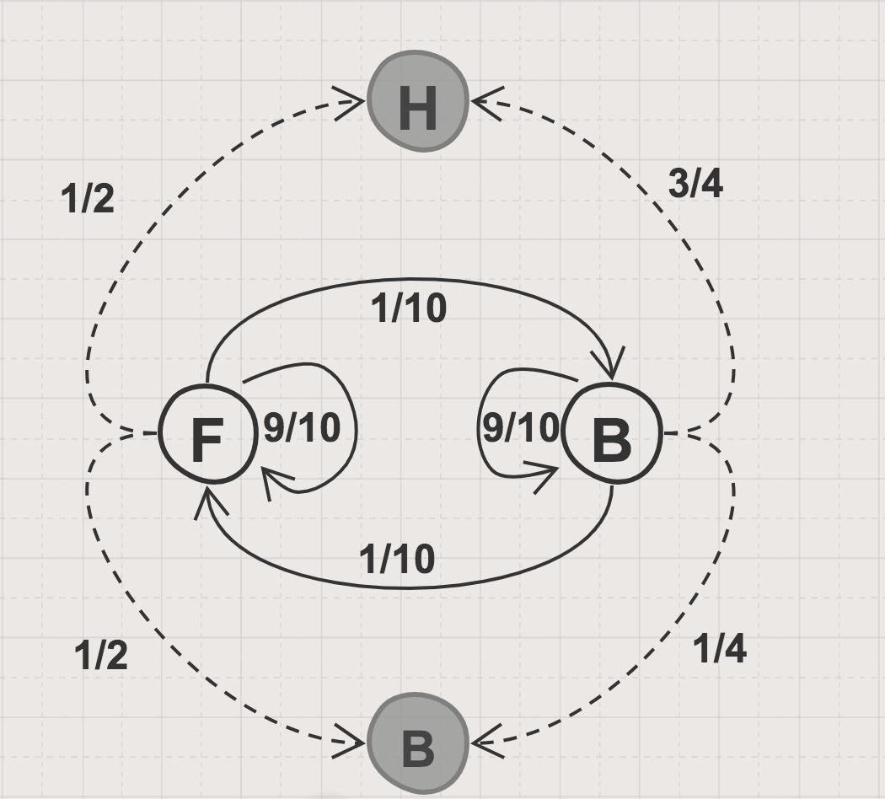
HMM for Heads or Tails Game
Emission
Transmission
 | Heads | Tails
Fair | 1/2 | 1/2
Biased | 3/4 | 1/4
 | Fair | Biased
Fair | 9/10 | 1/10
Biased | 1/10 | 9/10

Slide 5
Hidden Path
i | 1 | 2 | 3 | 4 | 5 | 6 | 7 | 8 | 9 | 10 | 11
x | T | H | T | H | H | H | T | H | T | T | H
s | F | F | F | B | B | B | B | B | F | F | F
P t | 1/2 | 9/10 | 9/10 | 1/10 | 9/10 | 9/10 | 9/10 | 9/10 | 1/10 | 9/10 | 9/10
P e | 1/2 | 1/2 | 1/2 | 3/4 | 3/4 | 3/4 | 1/4 | 3/4 | 1/2 | 1/2 | 1/2

Slide 6
Viterbi Algorithm

Slide 7
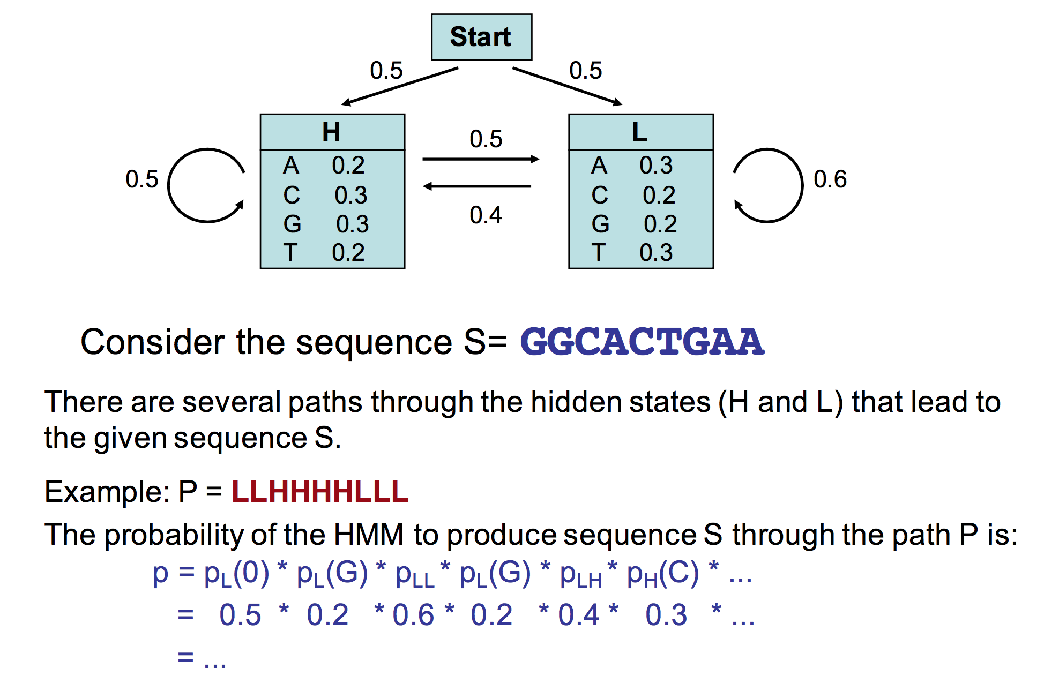
Viterbi Algorithm

Slide 8
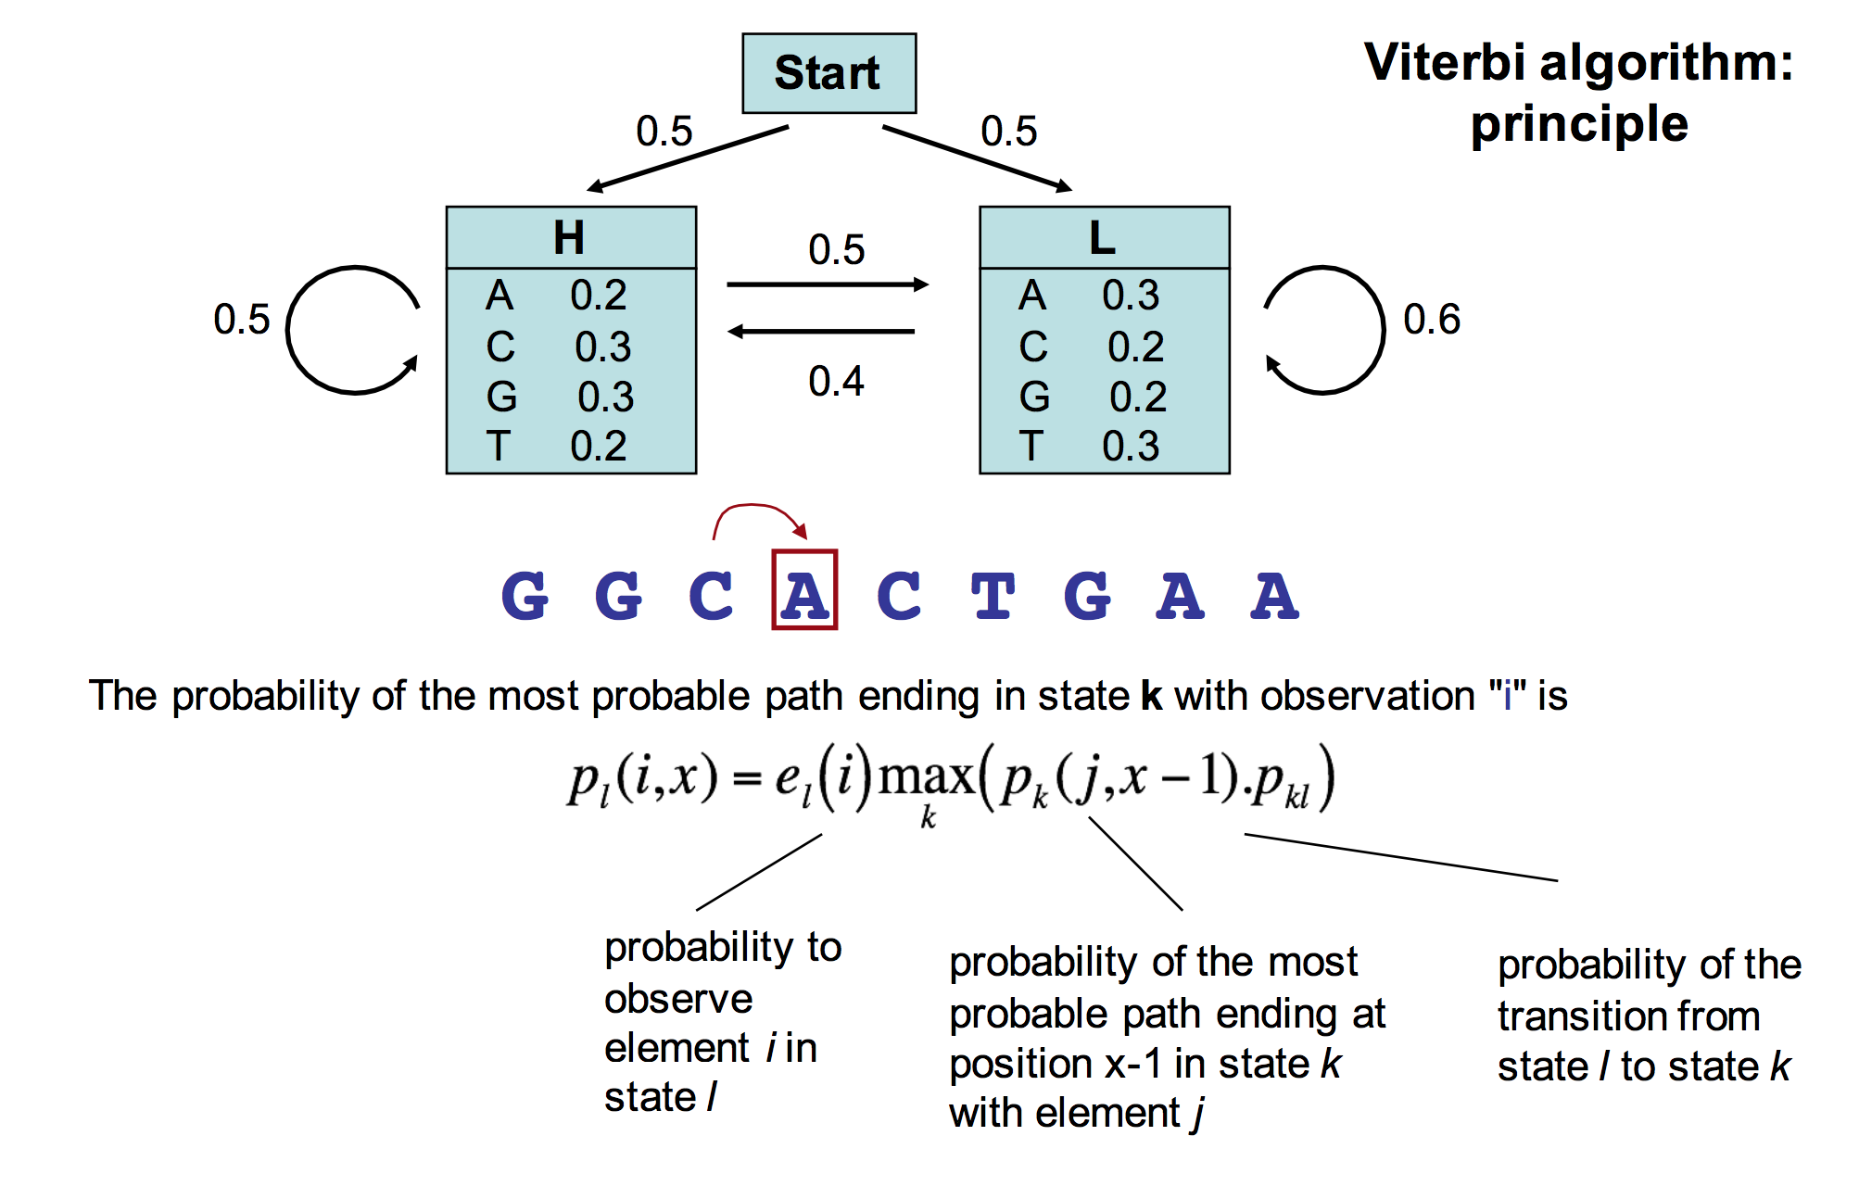
Viterbi Algorithm

Slide 9
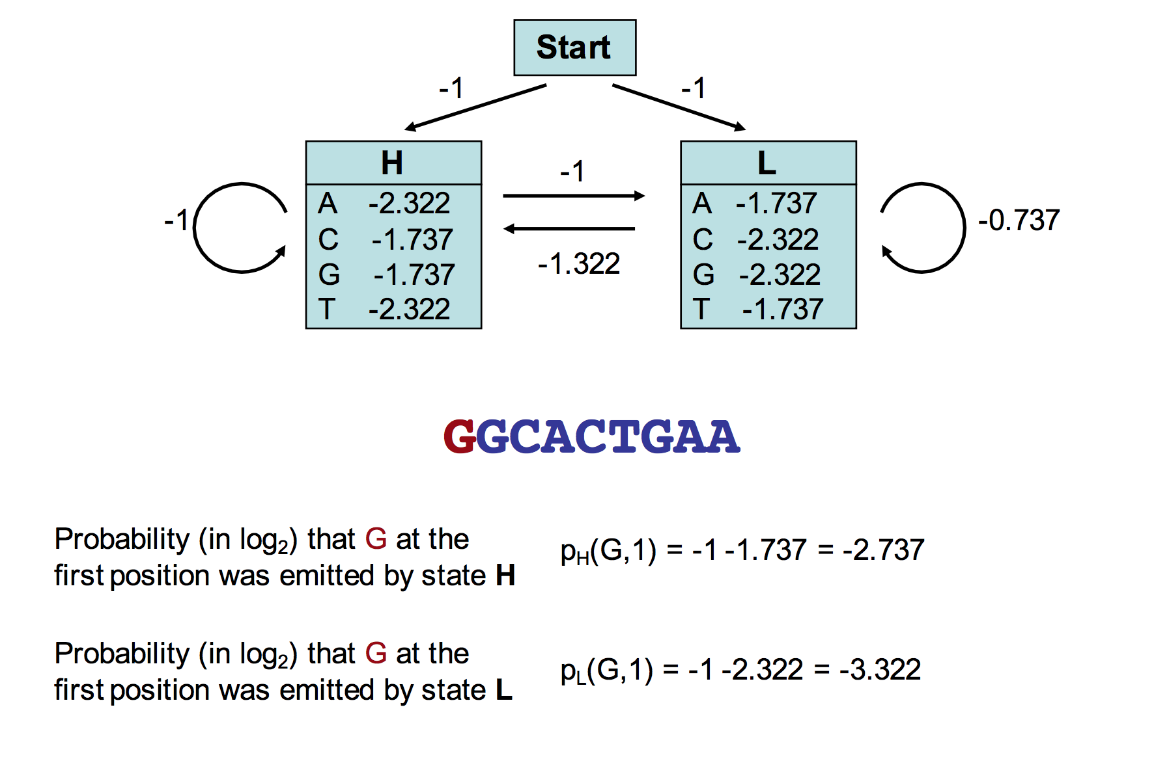
Viterbi Algorithm

Slide 10
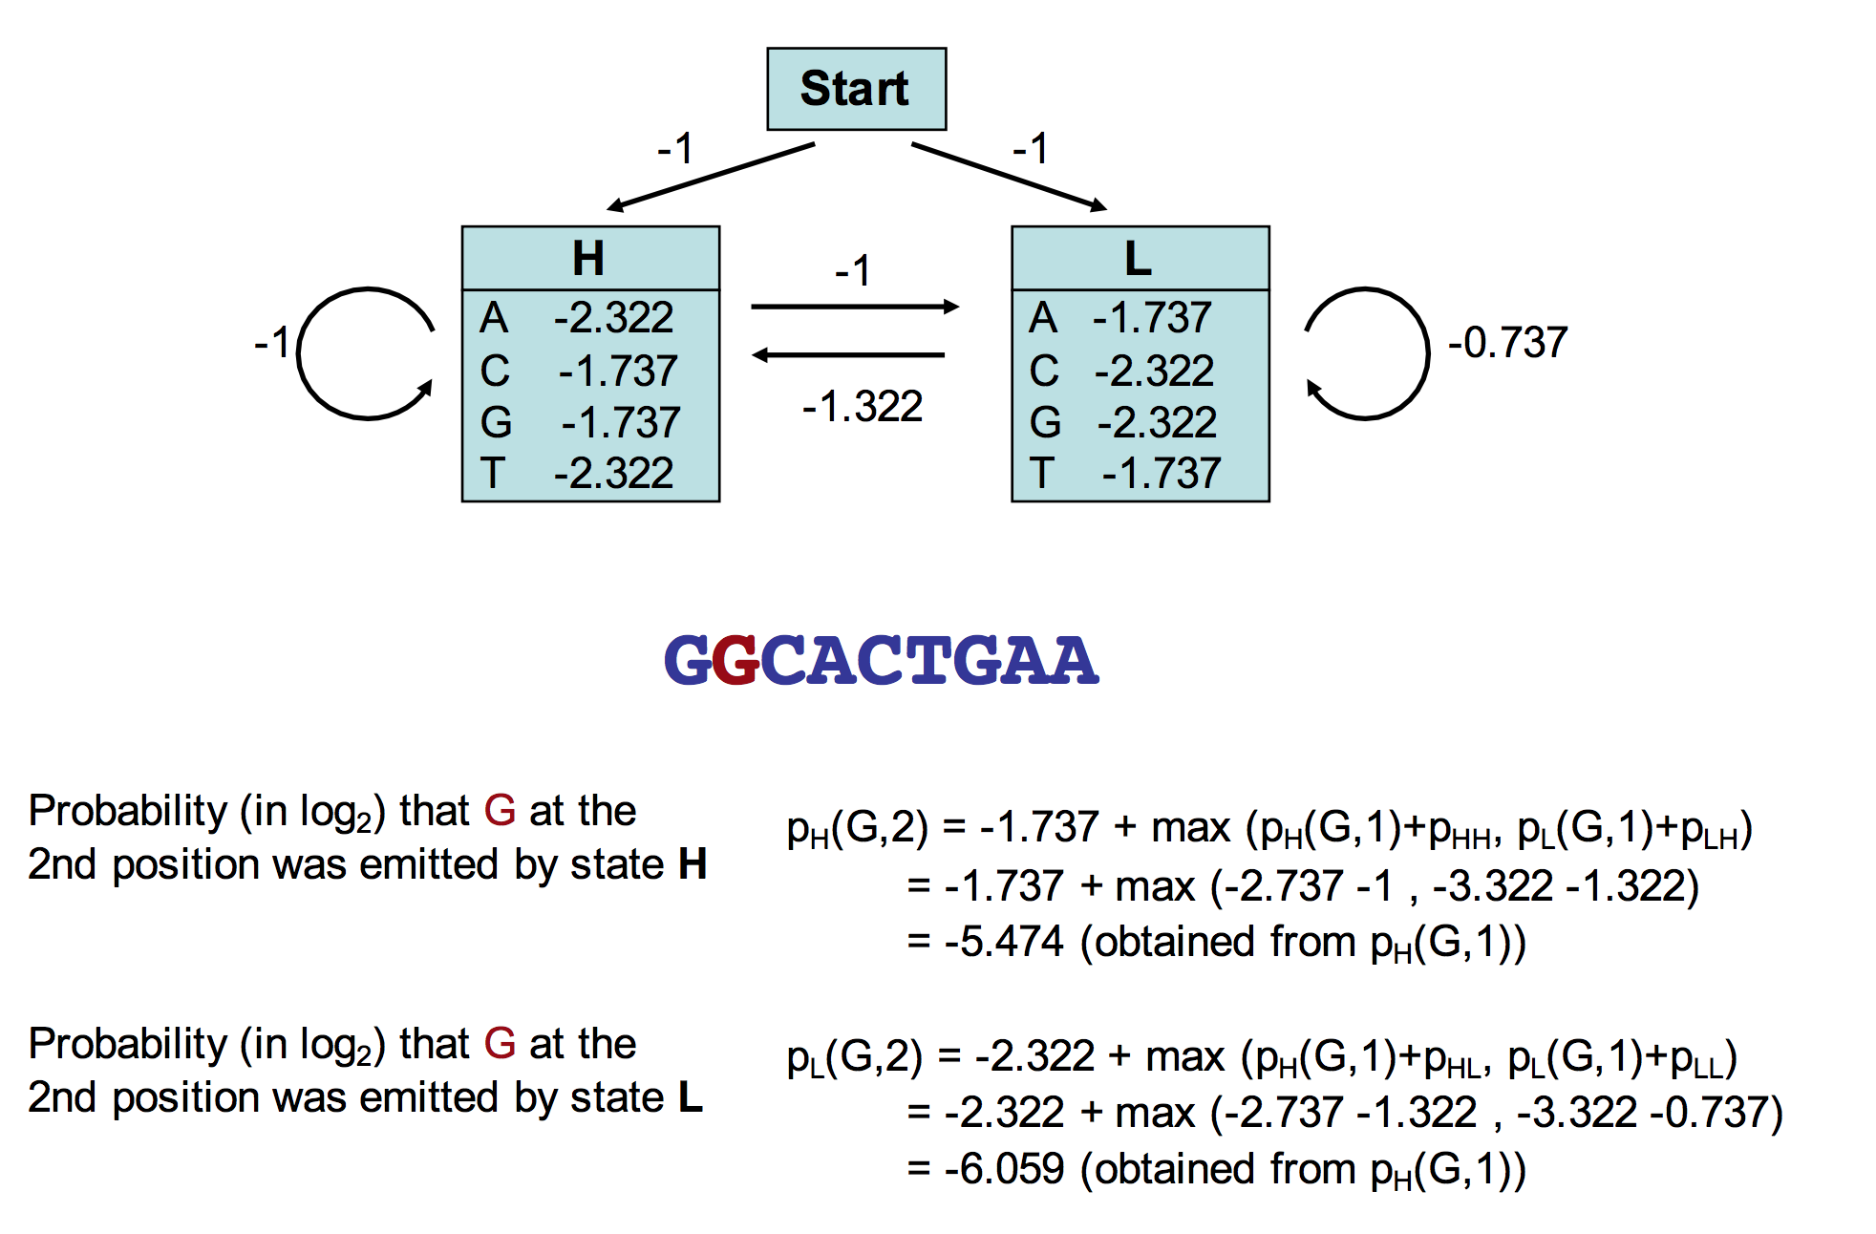
Viterbi Algorithm

Slide 11
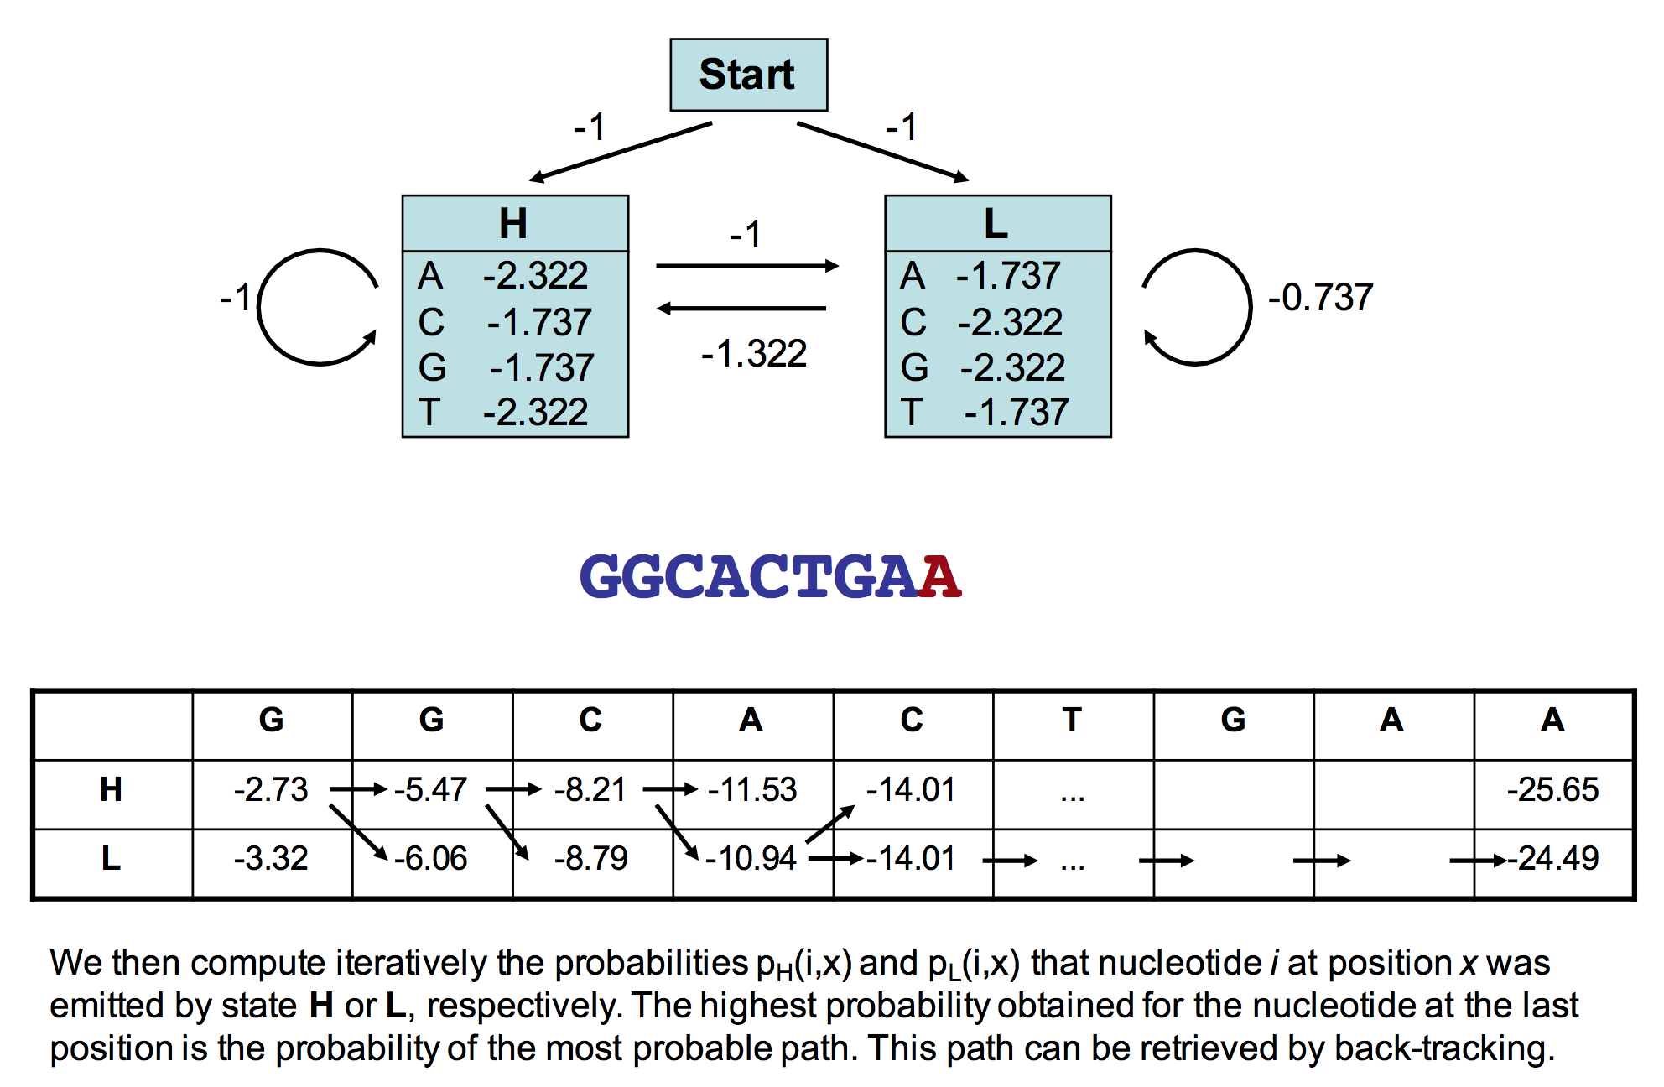
Viterbi Algorithm

Slide 12
HMM For Sequence Alignment

Slide 13
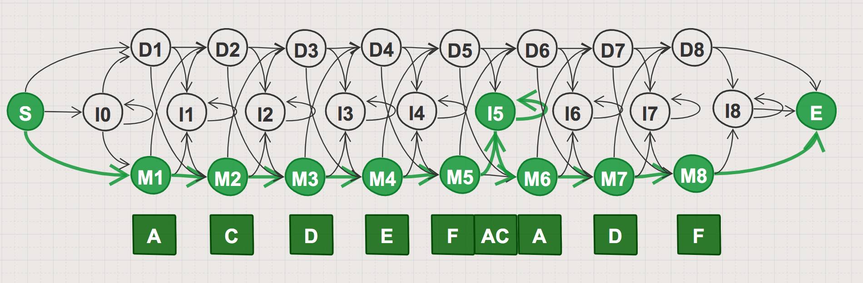
HMM For Sequence Alignment
A | C | D | E | F | AC | A | D | F
A | F | D | A | - | -- | C | C | F
A | - | - | E | F | D- | F | D | C
A | C | A | E | F | -- | A | - | C
A | D | D | E | F | AA | A | D | F

Slide 14
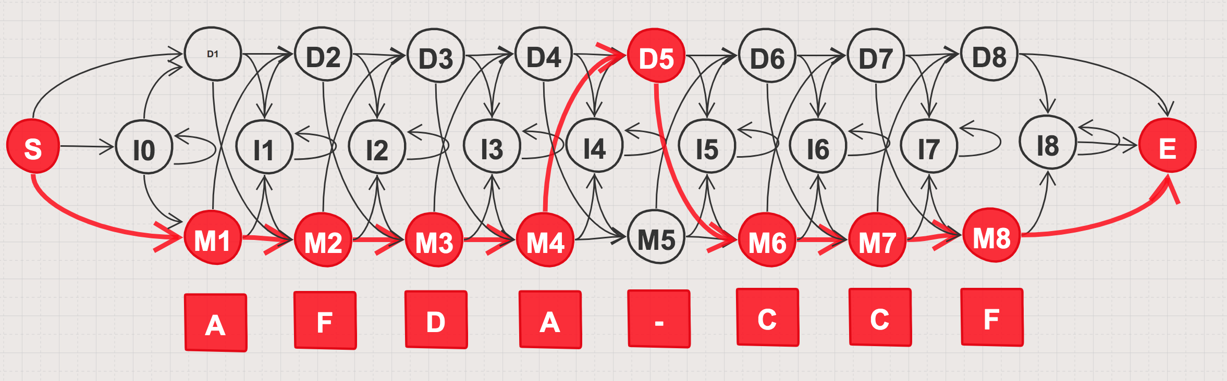
HMM For Sequence Alignment
A | C | D | E | F | AC | A | D | F
A | F | D | A | - | -- | C | C | F
A | - | - | E | F | D- | F | D | C
A | C | A | E | F | -- | A | - | C
A | D | D | E | F | AA | A | D | F

